Slide 1


Advisor : Hoon Sung Chwa
Weekly Meeting
2023.05.01
Dept of Information & Communication Engineering, DGIST
Real-Time Computing Lab
Kang Young Eun ( kye0520 @dgist.ac.kr)

Slide 2
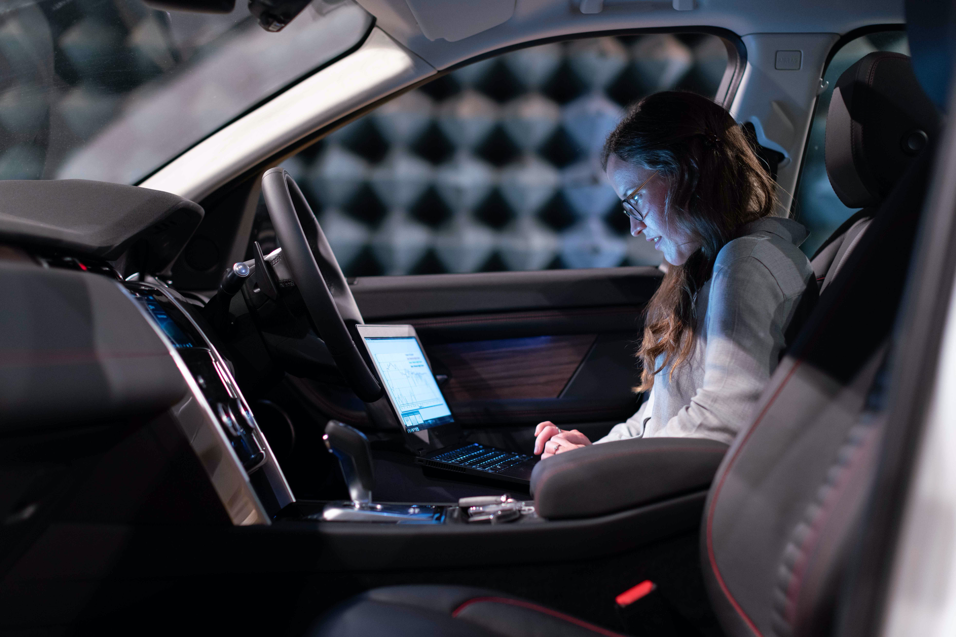
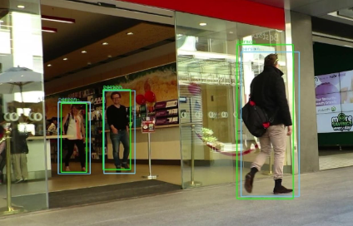

Introduction
Real time object detection in AVs
Deep Neural Network based Object detection tasks are applied.
Object detection task in safety-critical applications is critical to ensure safety of the system.
Current trend extends from single camera object detection to multi-camera object detection.
Autonomous Vehicles
Object Detection
Multi Camera
2
Notes:
Dnn의 발전으로 많은 AV에 DNN based object detection에 적용되고 있다.
Real time object detection task는 AV의 안전을 보장하는데 굉장히 중요하다.
그리고 최근에는 기존의 traditional object detection을 넘어, 여러 대의 카메라를 활용하는 multi camera object detectio을 통하여 주변의 환경을 파악한다.

Slide 3
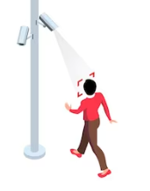
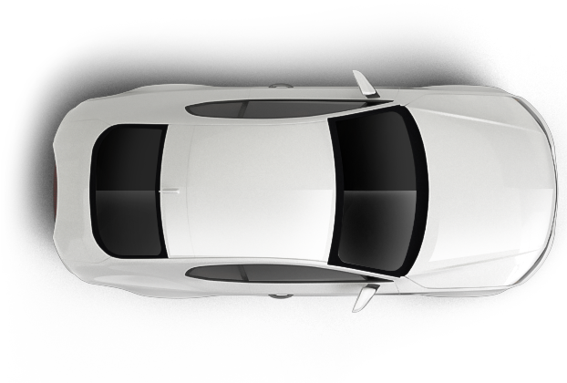
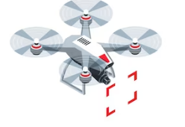
Introduction
Multi Camera Object Detection
Multi camera object detection made possible to handle complex and dynamic environments capturing different perspectives of scenes.
Multi camera object detection is applied to various scenarios.
Autonomous Vehicles
Surveillance Camera
Drones
Multi camera object detection tasks are now an essential part of our daily lives!
3
Notes:
많이 쓰이고 활용된다 use case들이 많이 있다.
차량, CCTV, drone에 다양하게 적용이 된다.
우리 삶에 많은 부분을 차지하고 있다.

Slide 4
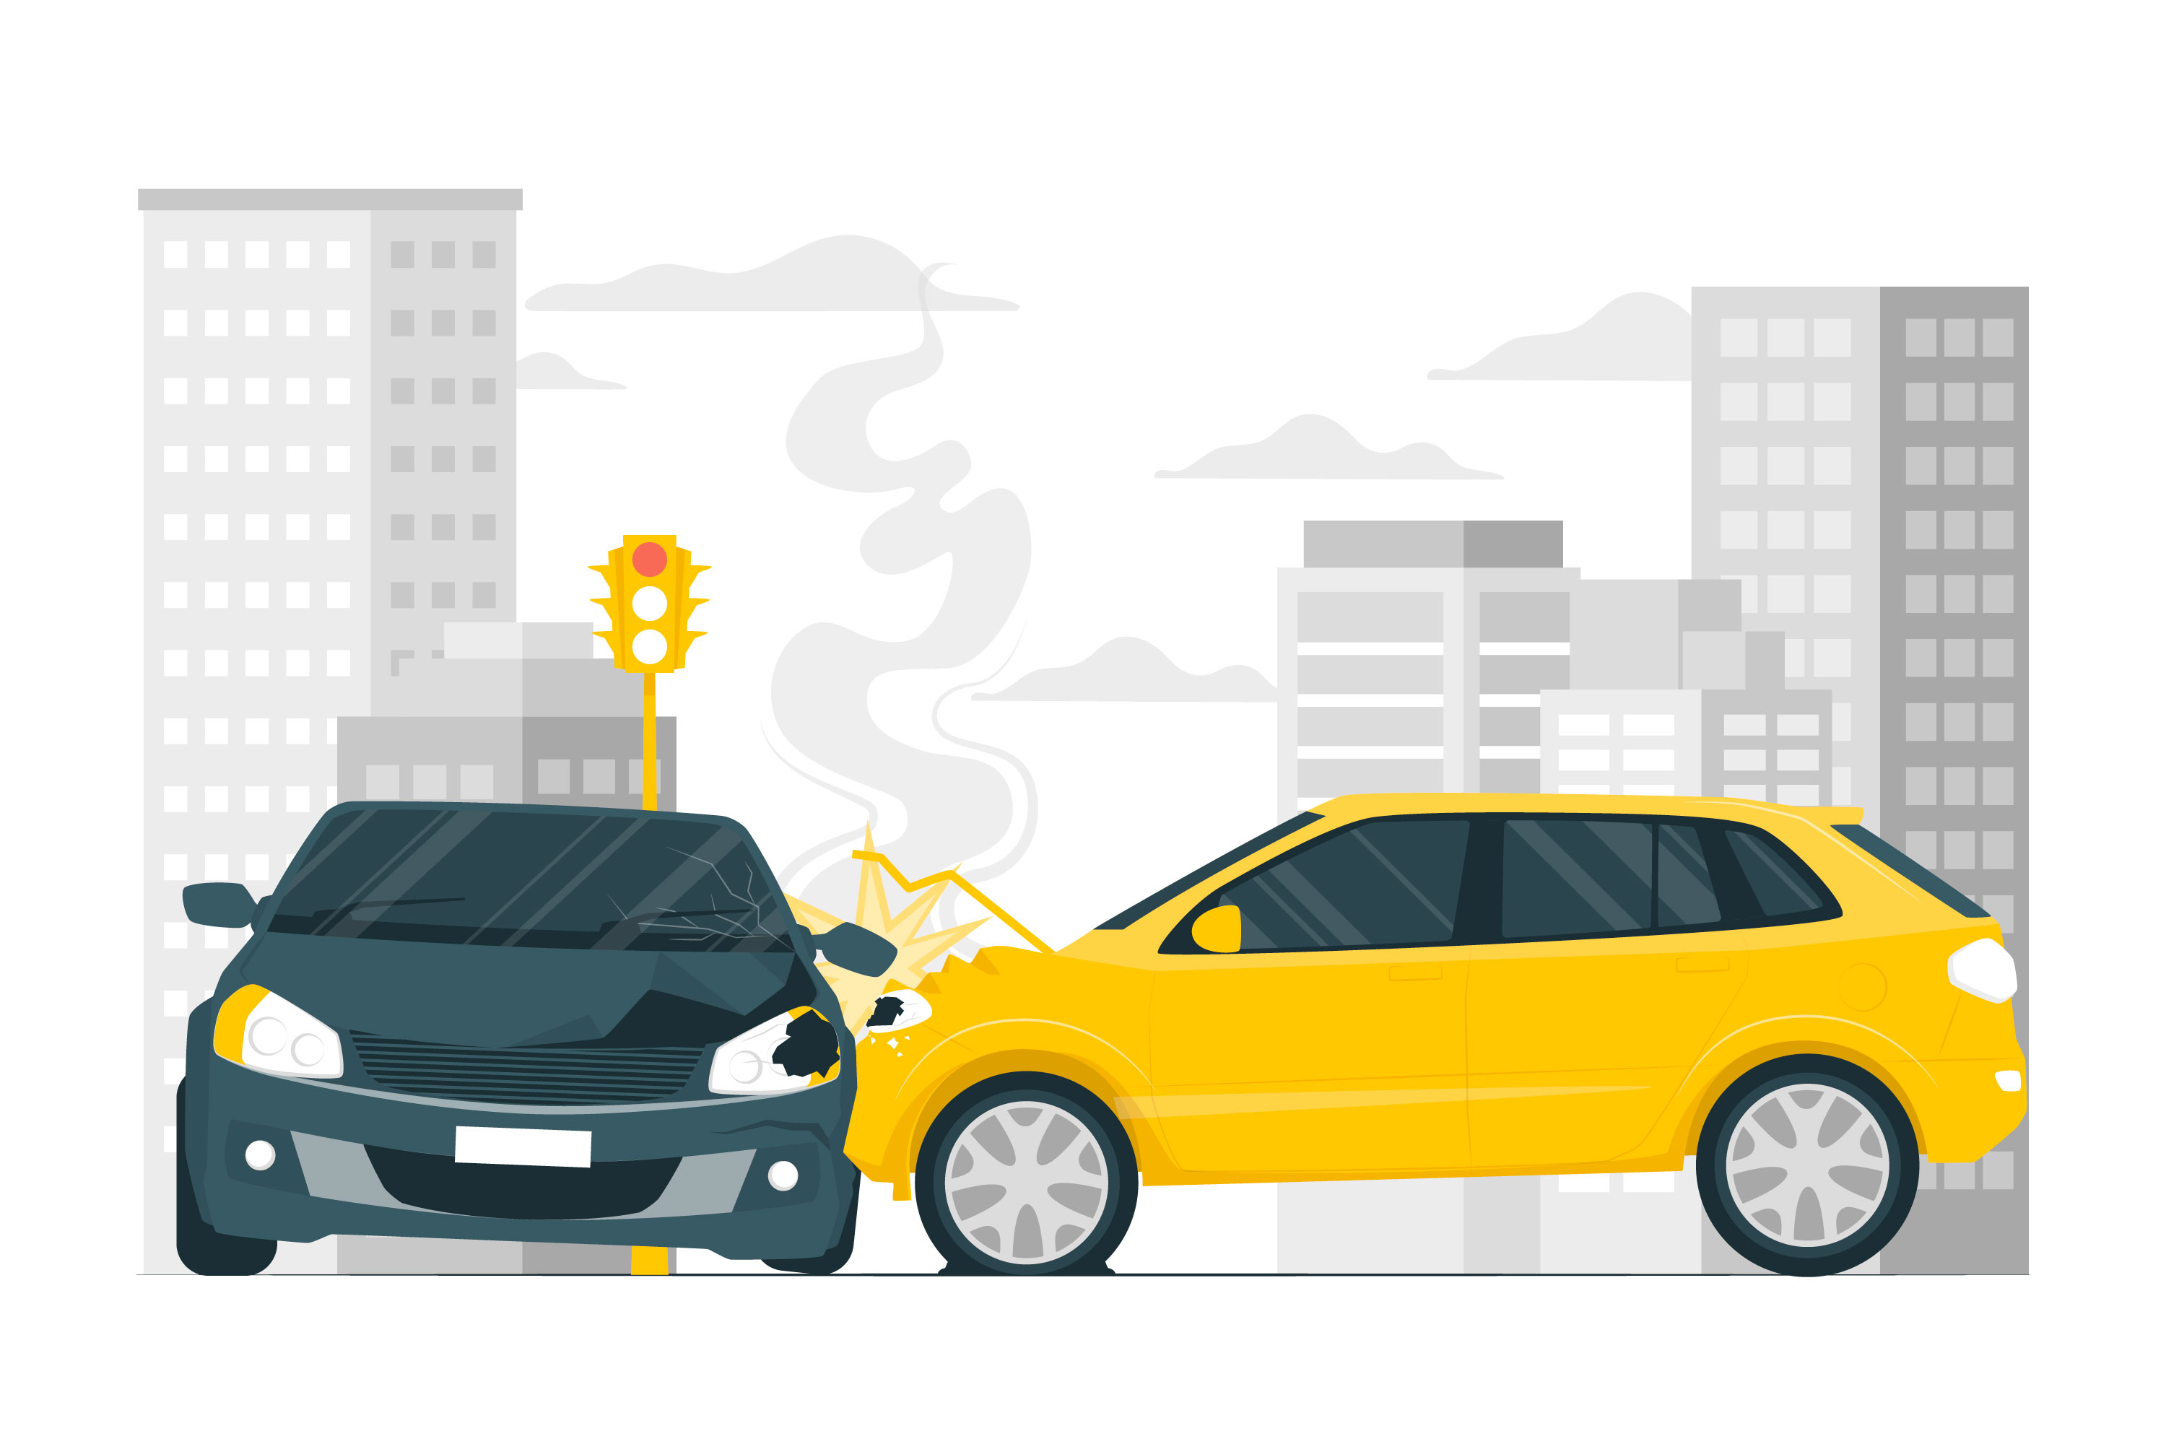
Introduction
Multi Camera Object Detection
Multi camera object detection commonly include safety critical tasks.
If not satisfied, it may lead to severe accidents.
Timely Inference is critical !
4
Notes:
그런데 이런 multicamera object detection 같은 경우
Multi camera objectr detection의 경우 timely inference가 지켜지지 않는 경우, 심각한 사고로 이어질 수도 있다.
따라서 timely inference가 중요하다.

Slide 5
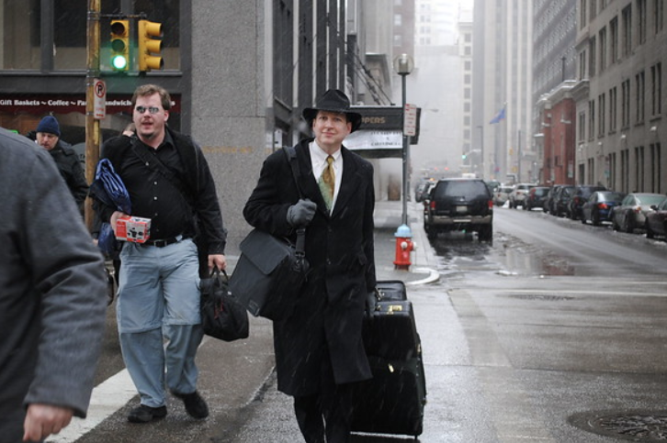
Introduction
Current DNN based Object detection tasks,
process image one at a time in a single computation cycle.
do not make efficient use of available resources.
do not consider different criticality of inputs in images.
Traditional Object Detection System
Input
Output
These facts make it difficult to enhance safety of real-time object detection tasks in AVs!
5
Notes:
그런데 current object detectio은 이러한 특성을 가지고 있어서
Multi camera object detection timely inference가 Traditional 방식으로는 어렵다.
Single computation cycle에 한번의 이미지만을 process 한다.
(merge)
(patch)

Slide 6
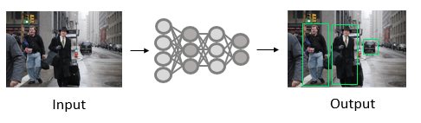
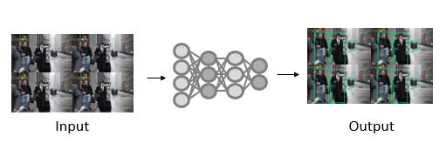
Introduction
Goal
Enhance safety of multi camera object detection system by presenting a timely object detection framework by utilizing :
Image Merge
Image Patch
Region-of-Interest
n times
only 1 time
Original Image Size
Enhance resource utilization by processing multiple images
Consider different criticality and lower computation
6
Notes:
따라서
1. Image merge를 활용하여 resource utilizatio을 해결하면서도 여러 이미지를 동시에 해결할 수 있다.
2. patch와 같은 computation saving framework를 활용하여 RoI의 criticality를 고려하면서 computation을 줄일 수 있었다.
따라서 이 2가지 기법을 활용하여 syste을 제안하여 multi camera object detection system의 안전성을 보장하는 것이 goal이다.
이와 같은 접근을 가능하게 한 2가지 observation.

Slide 7
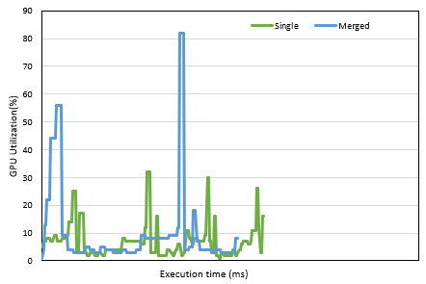
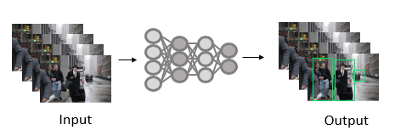
Motivation
Observation 1 : Image Merge enhances resource utilization
Traditional method does not fully utilize available resources.
Common Approach : Batching
GPU Utilization Comparison
Traditional
Batching 결과 추가
Merge
Batch
Merge utilize resource at a maximum of over 80%
7
Notes:
Image merge 같은 경우, traditional 방식과 비교했을 때 resourc를 훨씬 많이 utiliz할 수 있다는 것을 확인할 수 있었따.

Slide 8
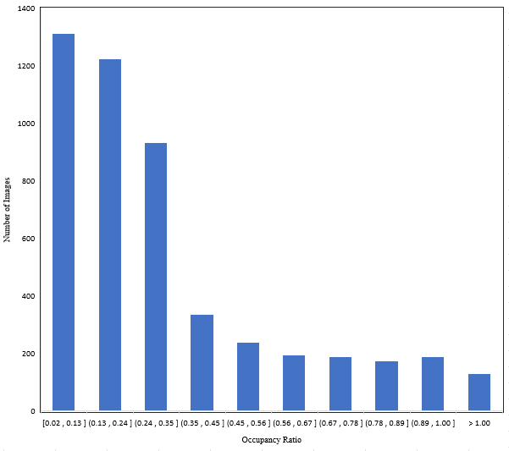
Motivation
Observation 2 : Image Patching lowers DNN computation
Proportion of Region of Interest (RoI) in an image covers a small amount
Occupancy Ratio of RoI in an image
77.8%
Lowered over 50% of original input
77% of possibility to lower computation over 50% of an image!
Therefore, image patching helps save DNN computational workload.
8
Notes:
이 문제점을 해결하기 위해서 frame에서 roi의 특성을 활용하고자 한다.
RoI 의 occupancy ratio를 측정한 결과, 이미지에서 차지하는 roi의 비중이 50%도 차지하지 않는 경우가 dataset의 77%나 되었다.

Slide 9
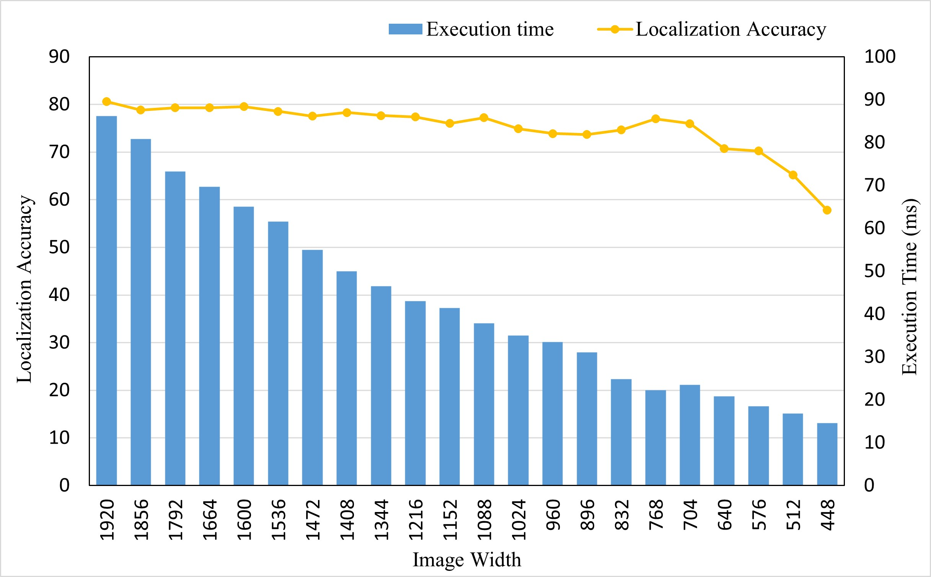
Motivation
Image Merge and Image Patch
Image Merging : Able to save utilize resources but merging multiple images at downsized image may lead to low accuracy.
Image Patching : Need RoI Localization Module.
Impact of Localization Accuracy on image resizing with Execution time
Image Patching Process
Classification 비교 추가
RoI Localization
Image merge applicable for localization
Therefore, we combine the two approach.
9
Notes:
이 두가지 기법을 활용하려다 보니 2문제가 있었다.
Merge 같은 경우 resource utilizatio은 올라갈 수 있겠으나 이미지를 downsizing등을 한다면 classification에 적용하기에는 정확도 문제가 발생할 수 있었다. 따라서 비교적 적게 떨어지는 localizatio에 활용하기 적합하였다.
2번째로 patching 같은 경우에 이를 활용하기 위해서는 roi localization 하는 모듈이 필요했다.
따라서 2가지를 결합하여 모델에 적용하게 되었다.

Slide 10
Motivation
Image Merge and Image Patch
Proposed model consists of two main parts : RoI Localization and Patching& Detection
To further consider meeting deadline of object detection, we apply Image Size Decision module
Decision Module
Merge Size
Patch Size
RoI Localization
Patching & Detection
Detection Results
Therefore, we apply a Decision Module that dynamically decides Merge size and Patch size according to deadlines.
10
Notes:
결합을 하면 다음과 같이 되는데
크게 Image merge기법이 포함된 RoI localization 방식과
이를 활용하여 Patching하여 detection 을 진행하는 Patching and detection modul로 구성되어 있다.
여기에 추가적으로 timely constraints를 맞추기 위해서 Decision Module을 추가하여 가장 모델 inference time에 영향을 많이 미치는 Merge의 사이즈 값과 Patching이 된 이미지의 사이즈를 deadlin에 따라 조절하도록 했다.
이와 같이 Merge Size와 canavas size를 설정함으로써 timely inference가 가능하도록 했다.

Slide 11
Model Design
Camera Image
Decision Module
RoI Detection
Image Merge
Object Detector
RoI result
Merge Size
1
2
Canvas Size
3
4
Bounding Box Mapping
Yolov5
Detection Result
Post Processing
Image Patching
Recursive Packing
RoI Size Decision
RoI Crop
Patch Module
11
Notes:
따라서 그 결과 Decision module 후 roidetection, image patching 후 detection을 진행하는 모델이 탄생하였다.

Slide 12

Advisor : Hoon Sung Chwa
Thank you
Dept of Information & Communication Engineering, DGIST
Real-Time Computing Lab
Kang Young Eun (kye0520@dgist.ac.kr)

Slide 13
Evaluation
Comparison Models
Vanilla : YOLOv5
Resizing vanilla
Batching
Merge+Patch Model (Ours)
Merge+Patch Model without density (scaling only)
Merge+Patch Model without object scaling (density only)
13
Notes:
deadline miss ratio
Classification accuracy
Breakdown latency of patching framework

Slide 14
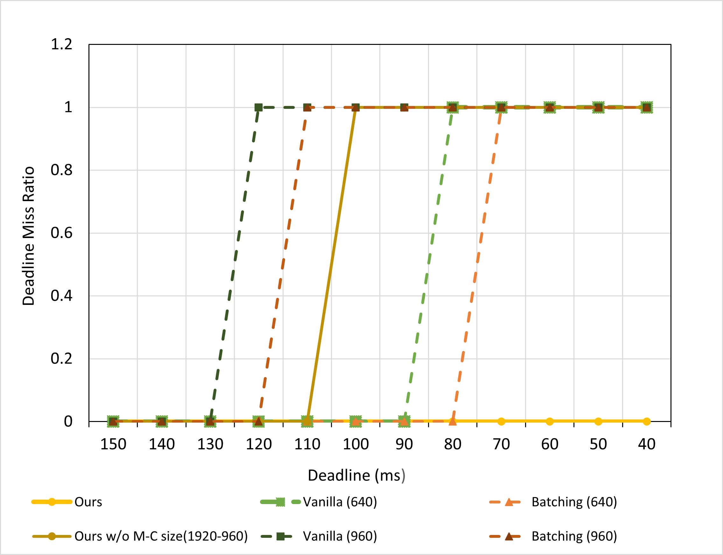
Evaluation
Deadline miss comparison
Deadline Miss ratio comparison
Vanilla is vulnerable to dynamically changing deadlines.
When processed with batch size of 4 , batching is inefficient in that because of the time it takes to load and process each batch.
Dynamically deciding Merge and Canvas size according to deadline helps meet deadline at any dynamically changing circumstances.
14
Notes:
1344-1536(100) 1600-1280(120) 1600-1664 (140)
optimal 한 batching 값이 있는데 우리 기준이 되는 개수로는 optimal 하지 못하다는 것.

Slide 15
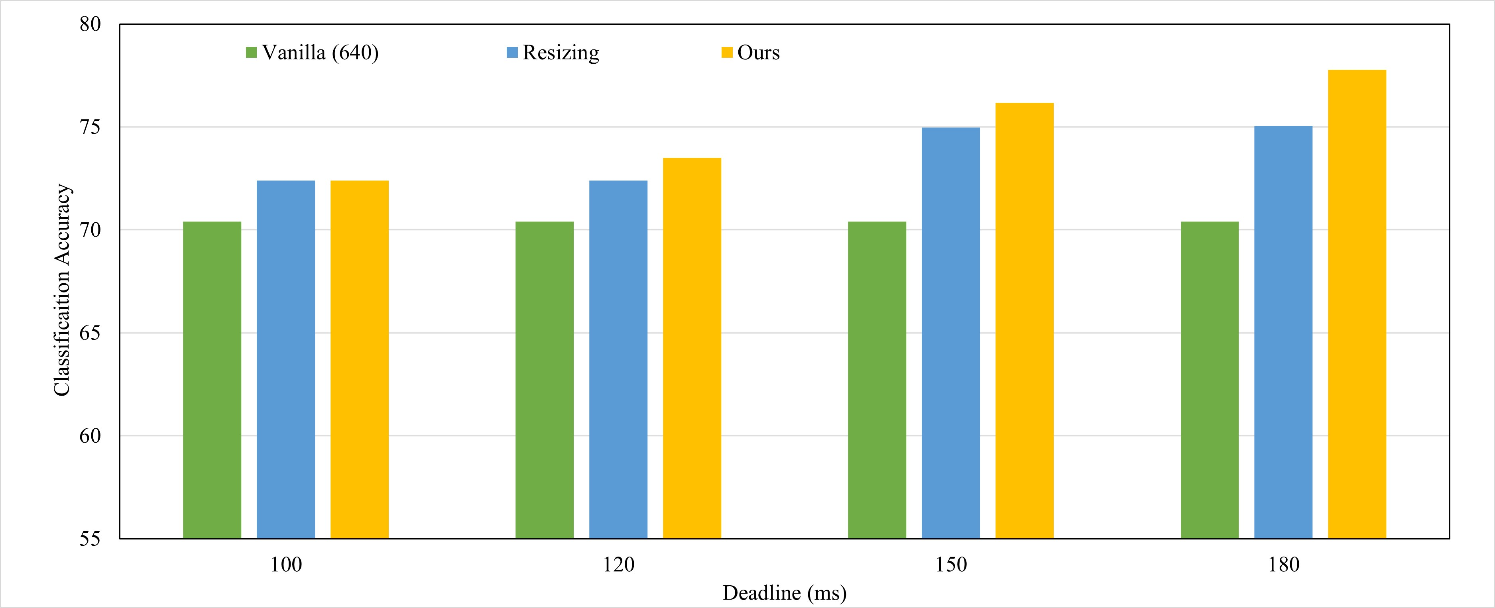
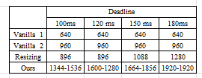
Evaluation
Average detection accuracy comparison with baselines
Corresponding Image Resolution
Results show our higher accuracy results without deadline miss
15

Slide 16
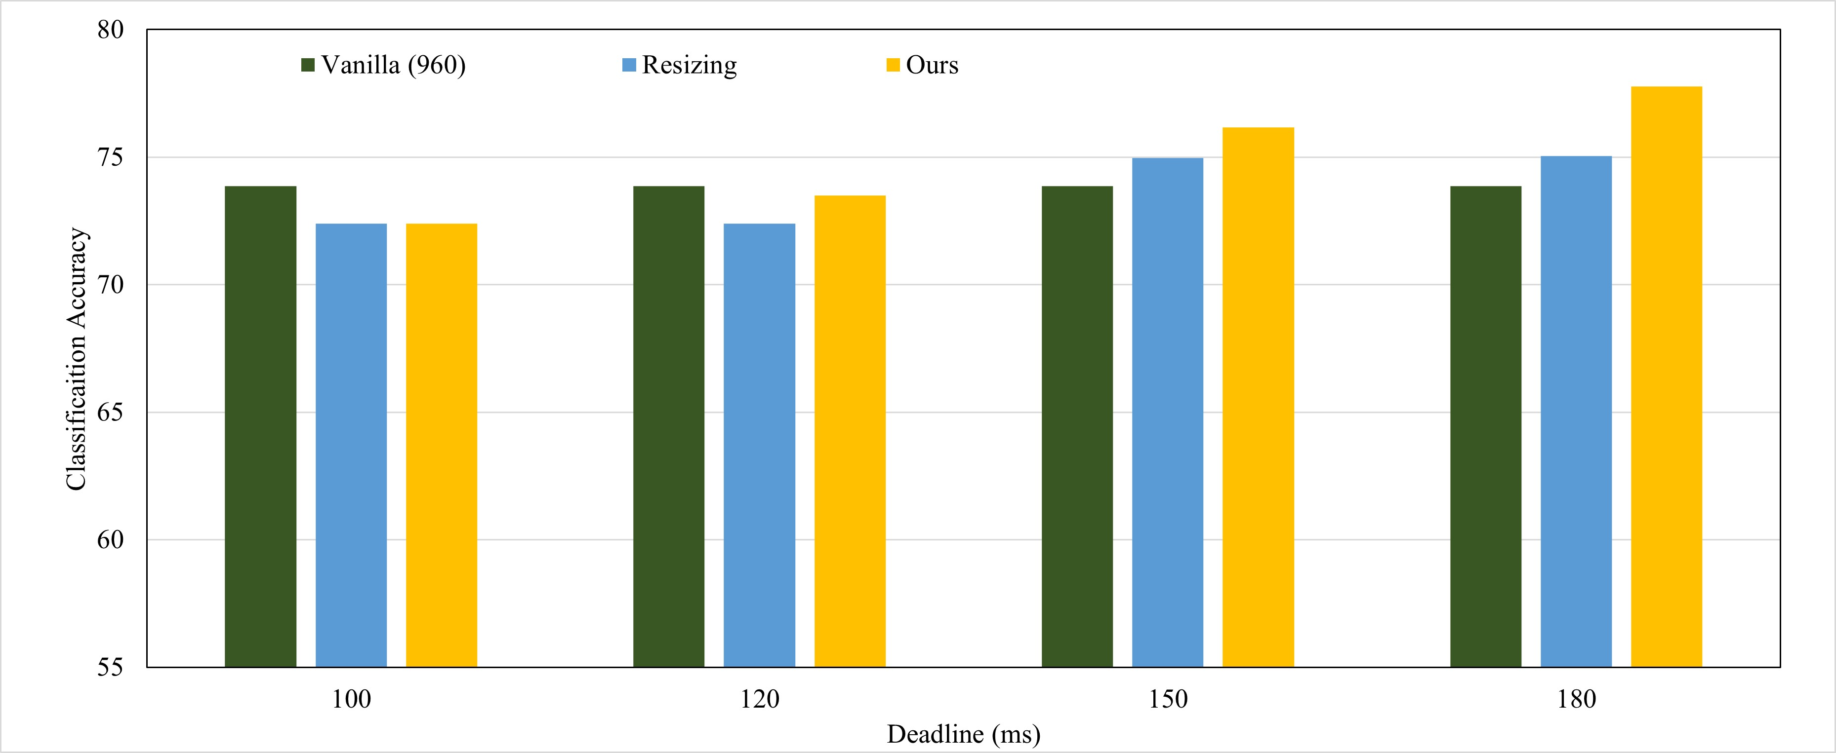
Evaluation
Average detection accuracy comparison with baselines
Corresponding Image Resolution
Results show our higher accuracy results without deadline miss
16

Slide 17
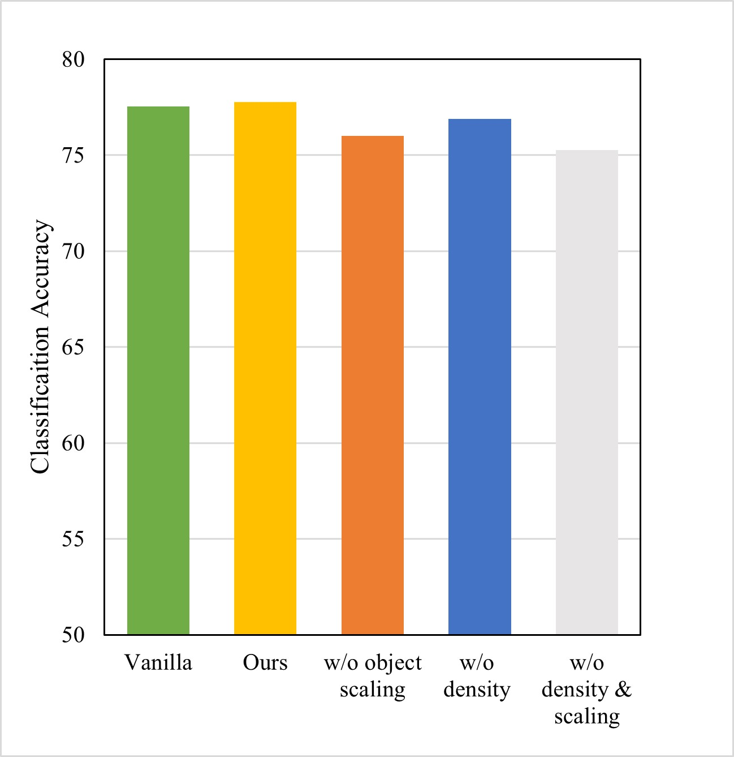
Evaluation
Classification Accuracy 2
Average detection accuracy comparison with and without object scaling and density
T
Therefore, object scaling and density consideration is essential approach to higher classification accuracy.
17
Notes:
Fps requirement/ deadline을 결정할

Slide 18
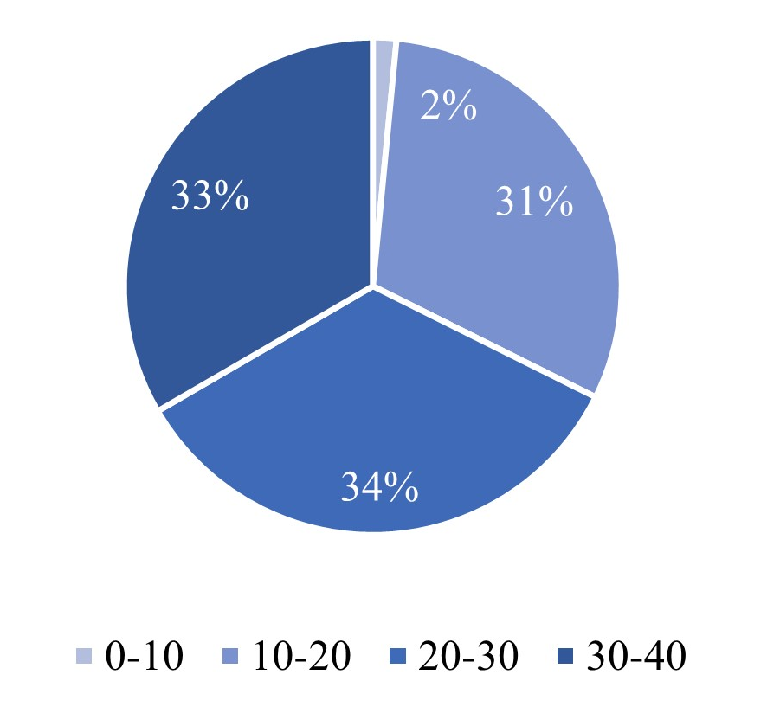
Evaluation
Classification Accuracy 3 : Density
Number of object distribution per frame
Accuracy of different density
Density Level
H : Frame of previous object number over 25.
L : Frame of previous object number under 25.
18
Notes:
Fps requirement/ deadline을 결정할

Slide 19
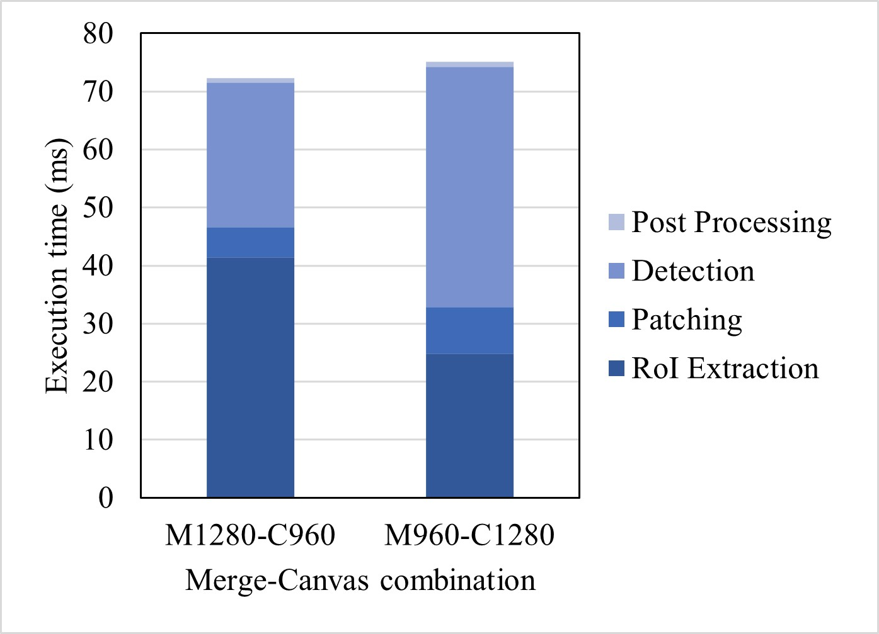
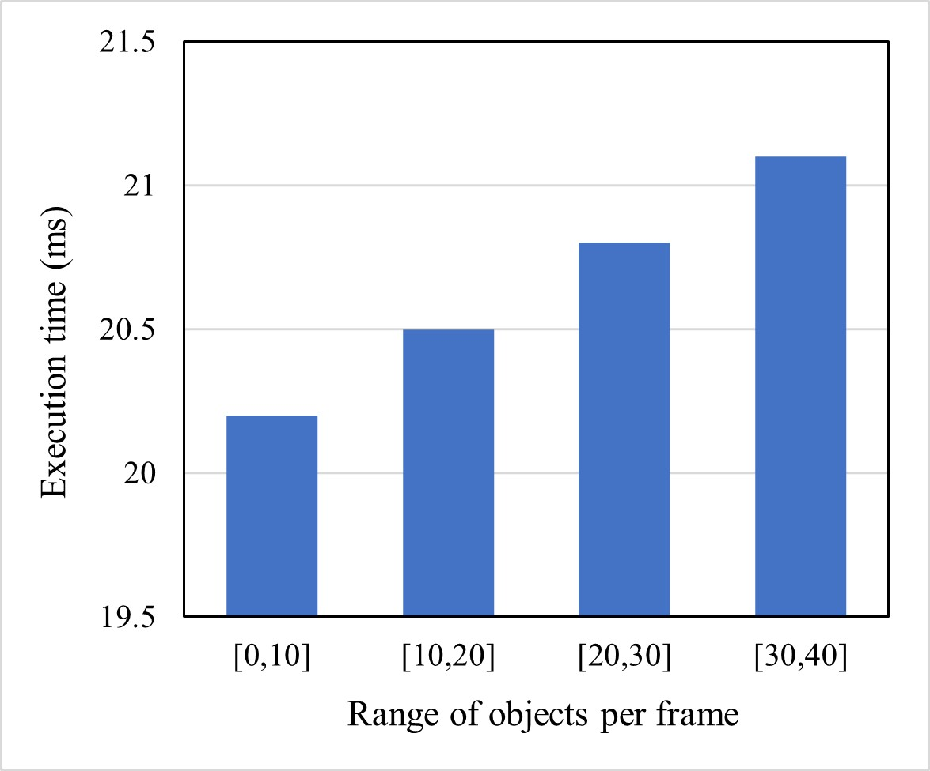
Evaluation
Breakdown latency of Patching framework
Breakdown latency of Patching framework
Patching execution time with the number of objects
0.9
Number of objects increases execution time.
Low gap between number of objects.
Execution time of patching only covers 5% and 8% respectively.
19
Notes:
Number of objects over 50%가 되더라도 execution time 증가 정도가 ~ 밖에 되지 않더라
그리 patching overhead가 크지 않다는 것보이기.

Slide 20
Model Design
1.Decision Module
20
Notes:
deadline miss ratio
Classification accuracy
Breakdown latency of patching framework

Slide 21
Model Design
2. RoI Detection
21
Notes:
deadline miss ratio
Classification accuracy
Breakdown latency of patching framework

Slide 22
Model Design
3. Image Patching
22
Notes:
deadline miss ratio
Classification accuracy
Breakdown latency of patching framework

Slide 23
Motivation Experiment
Execution time of localization per different image resolution
Merging images for localization is effective in terms of execution time.
23

Slide 24

Introduction
Deep Neural Networks
Deep Neural Networks (DNNs) are increasingly used in various real-time applications
Based on DNN models such as YOLO.
Share resources in embedded system.
Timely inference is critical for safety.
24
Notes:
이러한 객체 인식 task는 yolo와 같은 model 기반으로 사용.
여러 dnn task는 임베디드 컴퓨팅 환경에서 resourc를 공유하며 수행된다.
이러한 환경에서 안전을 보장하기 위해서는 Object detection task의 inference time을 제공하는 것이 중요하다

